Slide 1


Social Buzz

Slide 2


Today's agenda
Project recap
Problem
The Analytics team
Process
Insights
Summary

Slide 3

Social Buzz is a rapid growing social network company and digital nature of their core product, the amount of data that they create, collect and must analyze is huge. Accenture is running a 3 month initial project in order to prove to the client that we are the best firm to work with. They are expecting the following:
An audit of their big data practice
Recommendations for a successful IPO
An analysis of their content categories that highlights the top 5 categories with the largest aggregate popularity
Project Recap

Slide 4

Problem
Every day over 100,000 pieces of content, ranging from text, images, videos and GIFs are posted.
365,00,000 contents every year.
An analysis of their content categories that highlights the top 5 categories with the largest aggregate popularity

Slide 5



Andrew Fleming
Chief Technology Architect
The Analytics team
Marcus Rompton
Senior Principal
Nyi Nyi Bo
Data analyst

Slide 6
Process
1
Project background and data understanding
2
Data Cleaning
3
Data merging and modeling
4
Data analysis
5
Useful Insight

Slide 7

Insights
1.6K
“ANIMALS “ POST
1.897 K
REACTIONS TO “ANIMALS”
POSTS(MOST ARE “HATE” REACTIONS)
MAY
MONTH WITH MOST POSTS

Slide 8
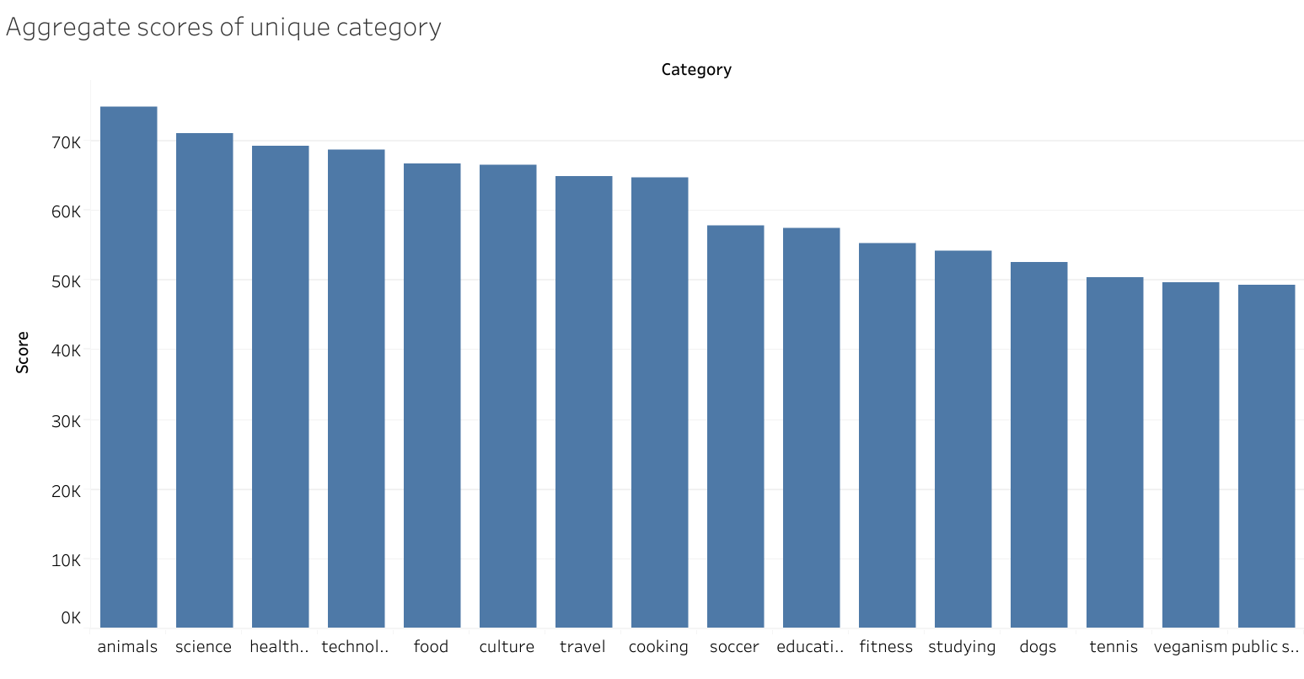
Notes:
-this is the aggregate scores distrib of each category
-the aggregate scores is calculated by means of how popular the content is(for eg how much reactions were given under the post)
- we decided the top 5 trending categories based on this scores
-name of 5

Slide 9
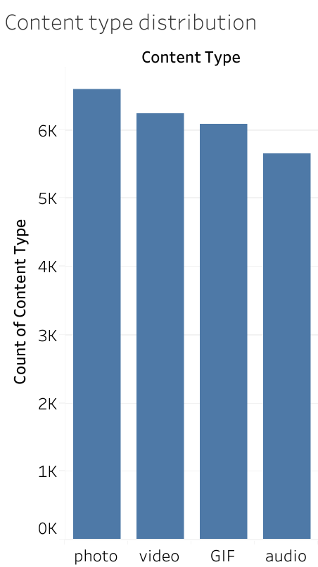
Notes:
-Next we want to talk about content type
-as you can see most contents are photos
-on the next slides we will see how types of contents are distributed based on each category

Slide 10
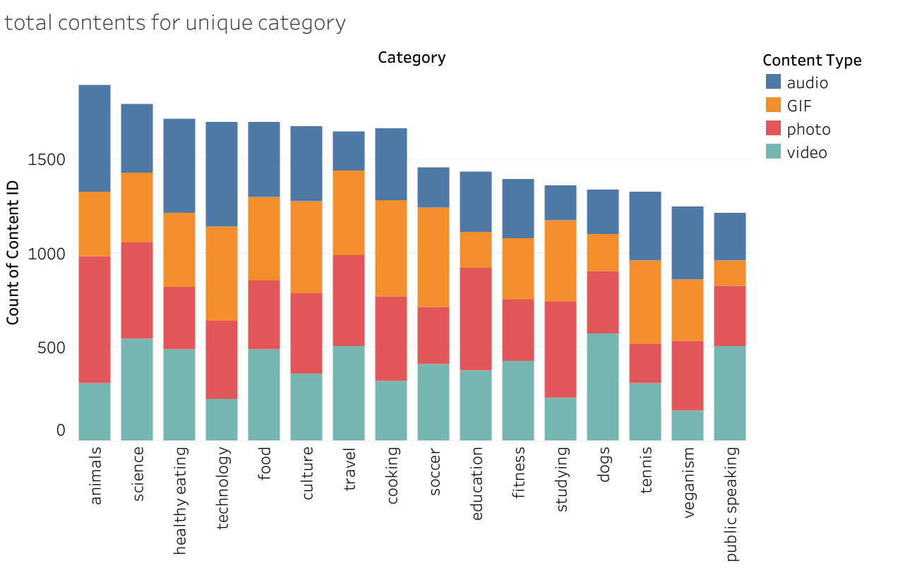
Notes:
-On this slide we also can see that the top 5 categories have the most contents .
- No wonder why they have higher aggregate scores
-As you can also see that most contents are photos for each category except contents for dogs, fitness and travel most of them are video contents

Slide 11
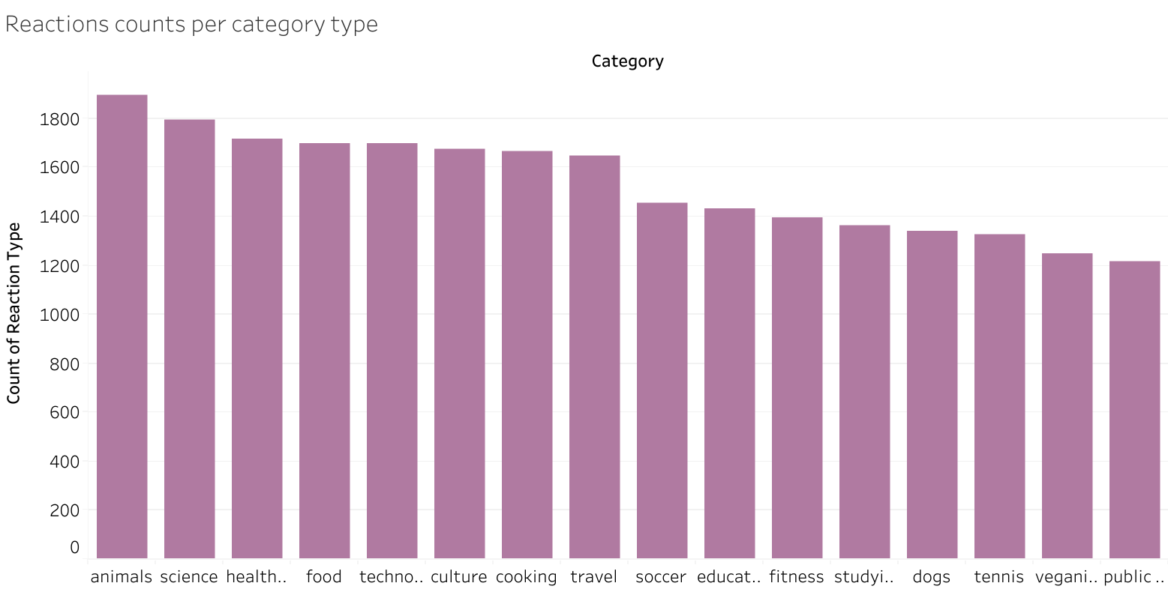
Notes:
- Next we will see reactions based on unique category
-Again top 5 contents also have the most reactions count
-Like we mentioned above the scores is calculated based on popularity and populare contents tends to get more reactions that not hard to understand I believe

Slide 12
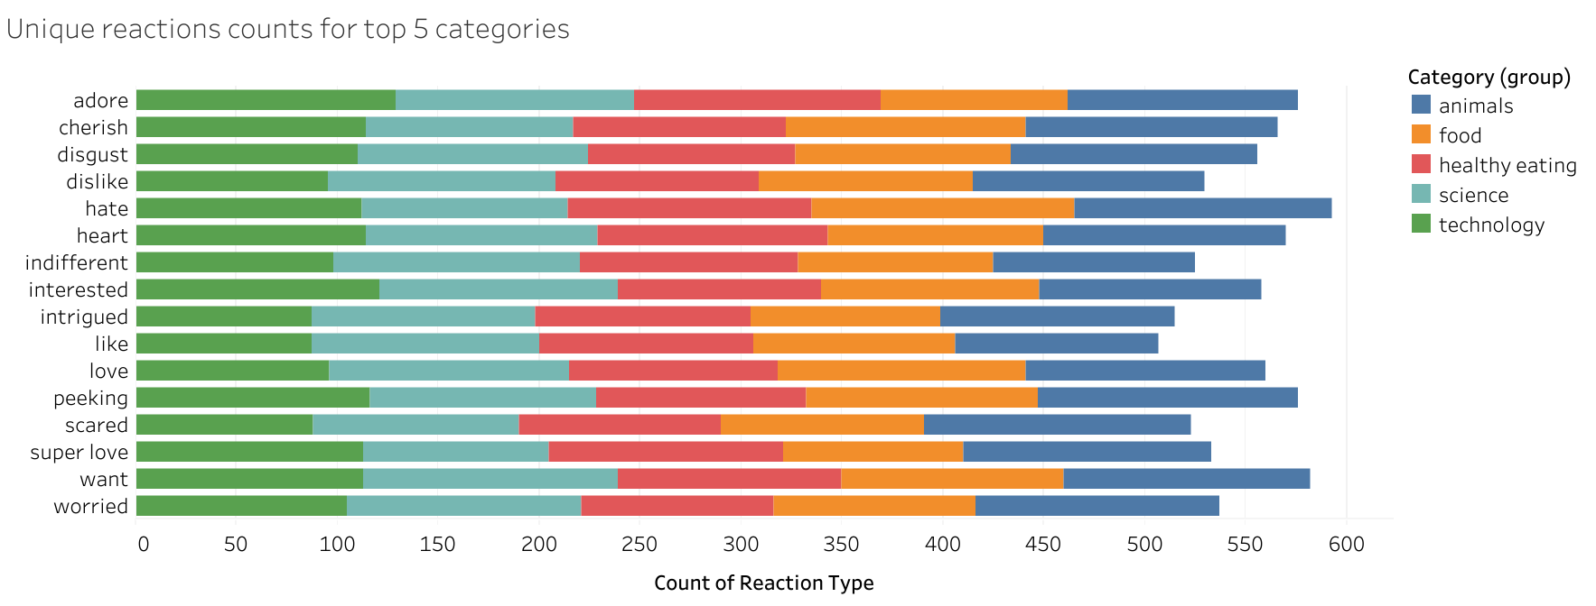
Notes:
- On this slide, we will emphasize on top 5 categories
- and how unique reactions was given to them
-According to the bar chart ( hate and want reactions are most common )
- and like or thumbs up reactions was least common
- all types of reactions are uniformly given to specific category

Slide 13
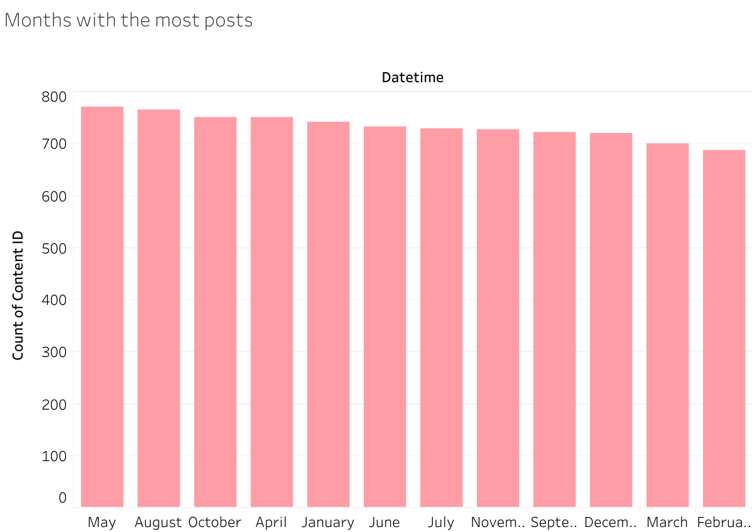
Notes:
-Next we will emphasize on time
-Through out years may, august and October were the months with the most post created
-However, the number was not that different, the range is only about 20 to 30 posts difference between months

Slide 14

Top 5 categories
Animals
Food
Healthy eating
Science
Technology
According to the analysis these 5 categories have
Most contents
Most reactions
Hate, want and peeking reactions are most common among others.
INSIGHT
Food is a common theme with the top 5 categories with “Healthy Eating” ranking the highest. This may given an indication to the audience within your user base. You could use this insight to create a compagn and work with healthy eating brands to boost user engagement
NEXT STEPS
This ad-hoc analysis is insightful, but it’s fine to take this analysis into large scale production for real-time understanding of your business. We can show you how to do this.
Summary

Slide 15
Thank you!
ANY QUESTIONS?

